Slide 1


EFFECTIVE POTENTIALS IN GENERAL
SCALAR-TENSOR THEORIES OF GRAVITY
24RL-1C036
HRIPSIME K. TERYAN,
A.A. SAHARIAN, G.H. HARUTYUNYAN, R.M. AVAGYAN
DOI: 10.1007/s10511-026-09912-6

Slide 2
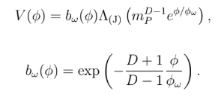

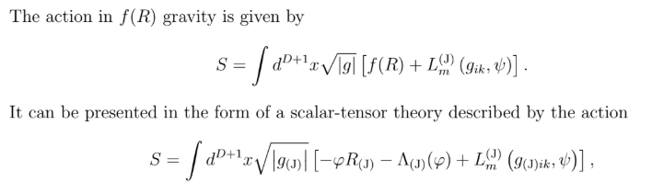
Abstract
We consider general scalar-tensor theories in (D+1)-dimensional spacetime. The interplay between the Jordan and Einstein frame representations is explored. As a specific illustration of the general framework, we examine higher-dimensional generalizations of the Jordan-Brans-Dicke theory, theories with nonminimally coupled scalar fields, f(R) gravity and low-energy string effective gravity. The properties of the Einstein frame scalar field effective potentials are discussed.

Slide 3


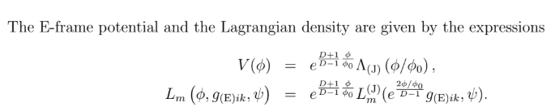
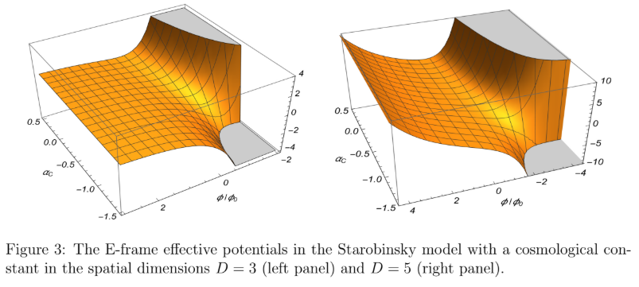

Slide 4
Acknowledgments
The work was supported by the grant No. 24RL-1C036 of the Higher Education and Science Committee of the Ministry of Education, Science, Culture and Sport RA.
THANK YOU FOR YOUR
ATTENTION

